Slide 1
What is the one thing that you remember as a child?

Slide 2
EVERY SOCIETY HAS TO TAKE CARE OF IT’S CHILDREN & CHILDHOOD

Slide 3
A CHILD
FRIENDLY
CITY
Nurture and design for childhood

Slide 4
“Children are a kind of indicator species. If we can build a successful city for children, we will have a successful city for all people”
– Enrique Penalosa (Columbian Politician – Mayor of Bogota)

Slide 5

Initiated in 2007 | Ahmedabad
Ahmedabad | Rajkot | Baroda| Aurangabad | Hyderabad | Kolkata| Surat | Sangamner | Jodhpur

Slide 6
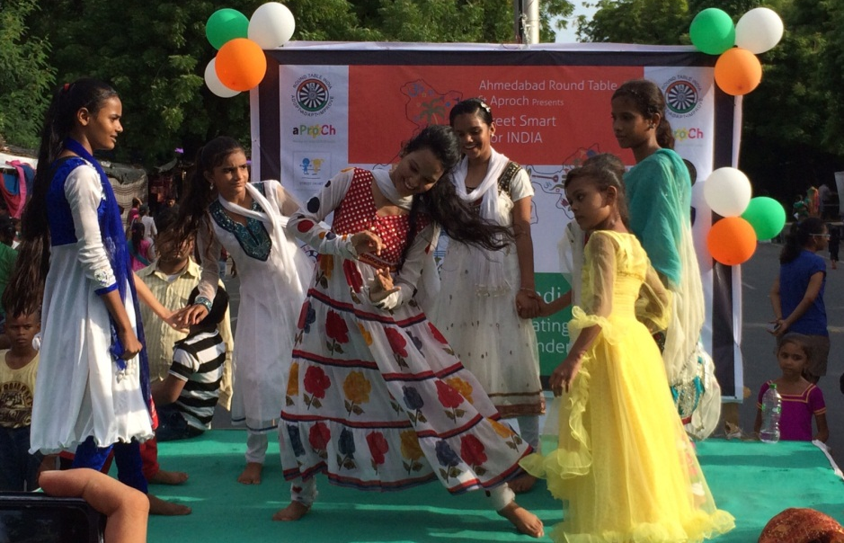
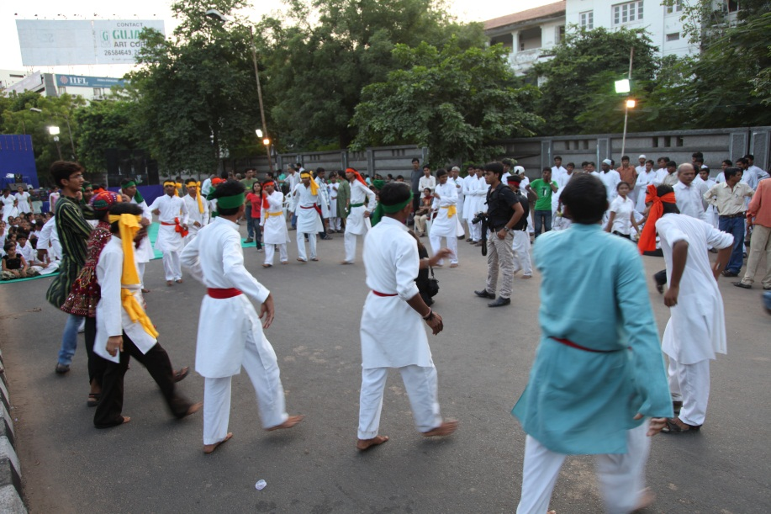
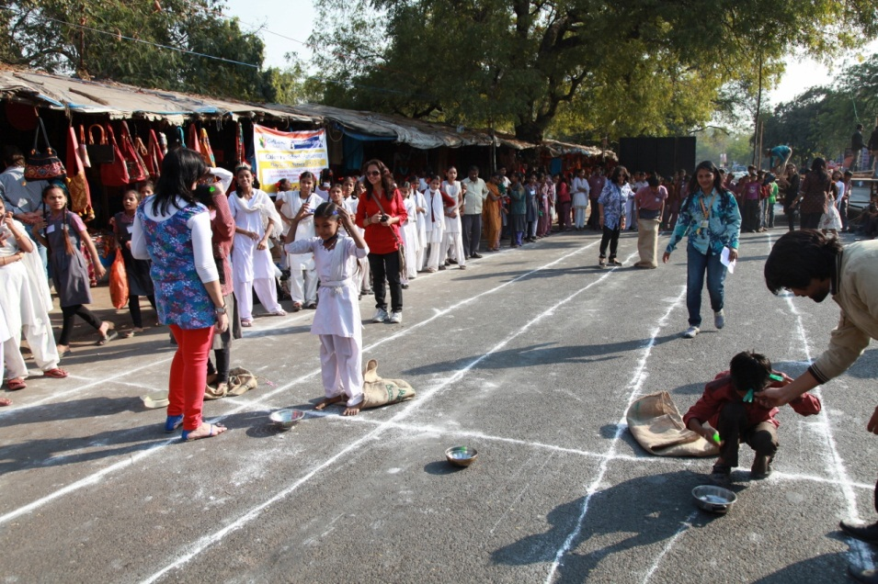
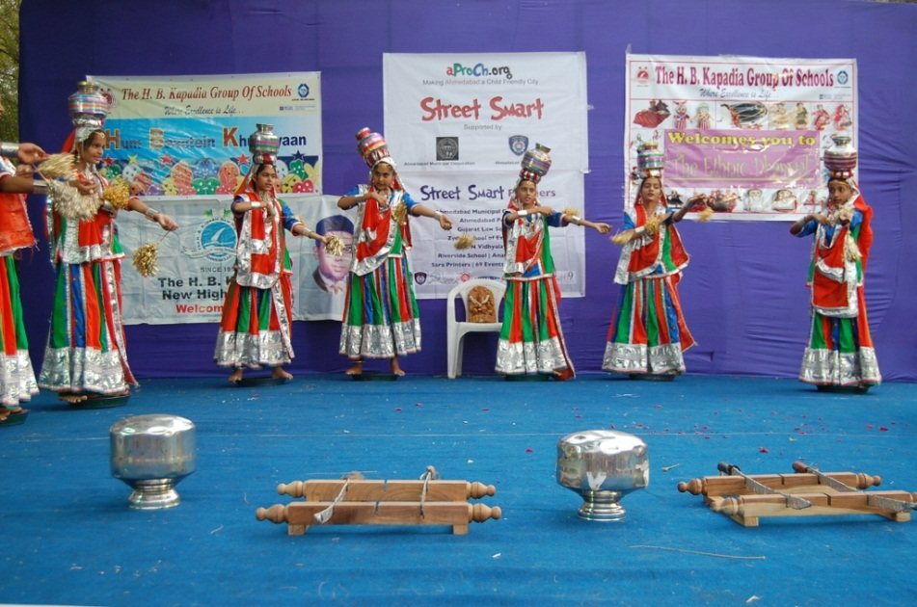
Innovations - Open space
Street Smart – City as my playground

Slide 7
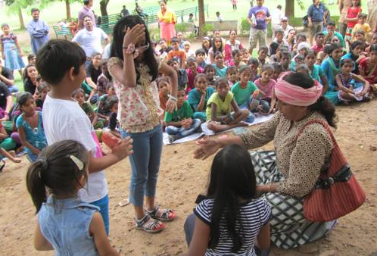
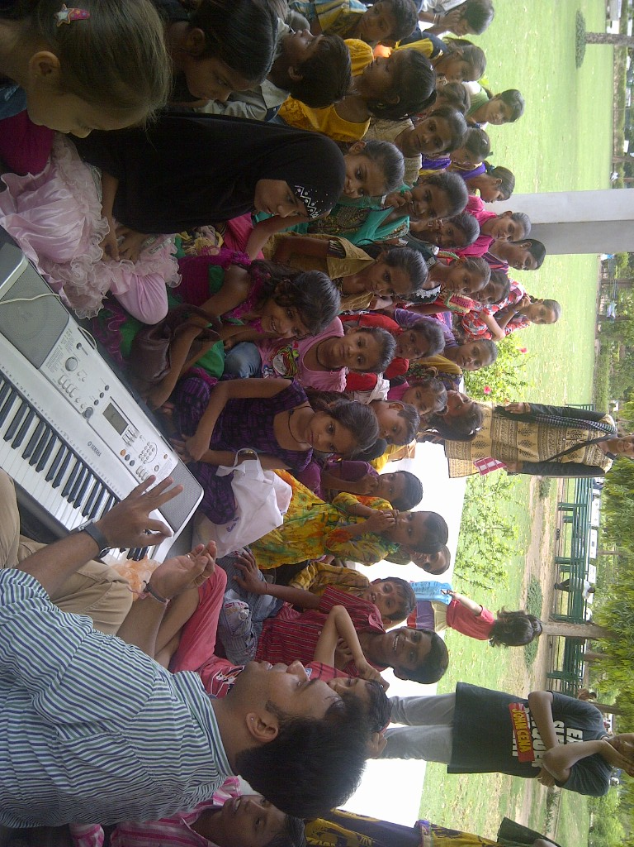
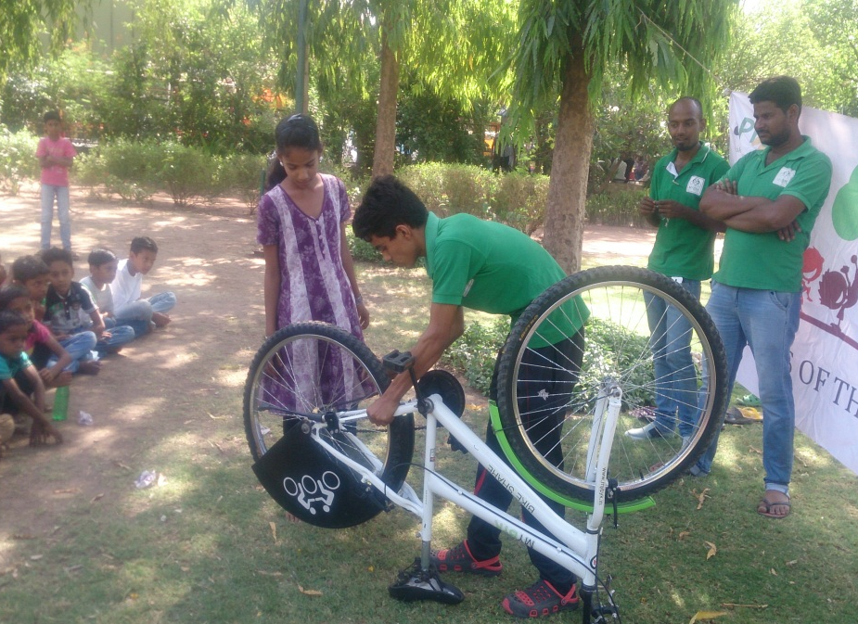
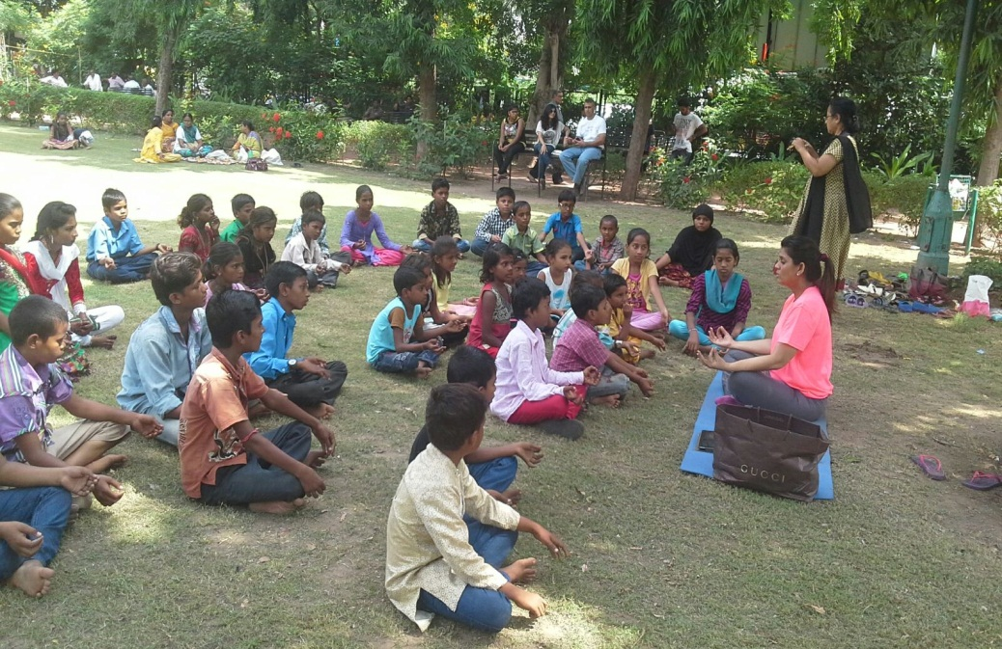
Innovations - Open space
Parents of the Park – bringing parks alive

Slide 8
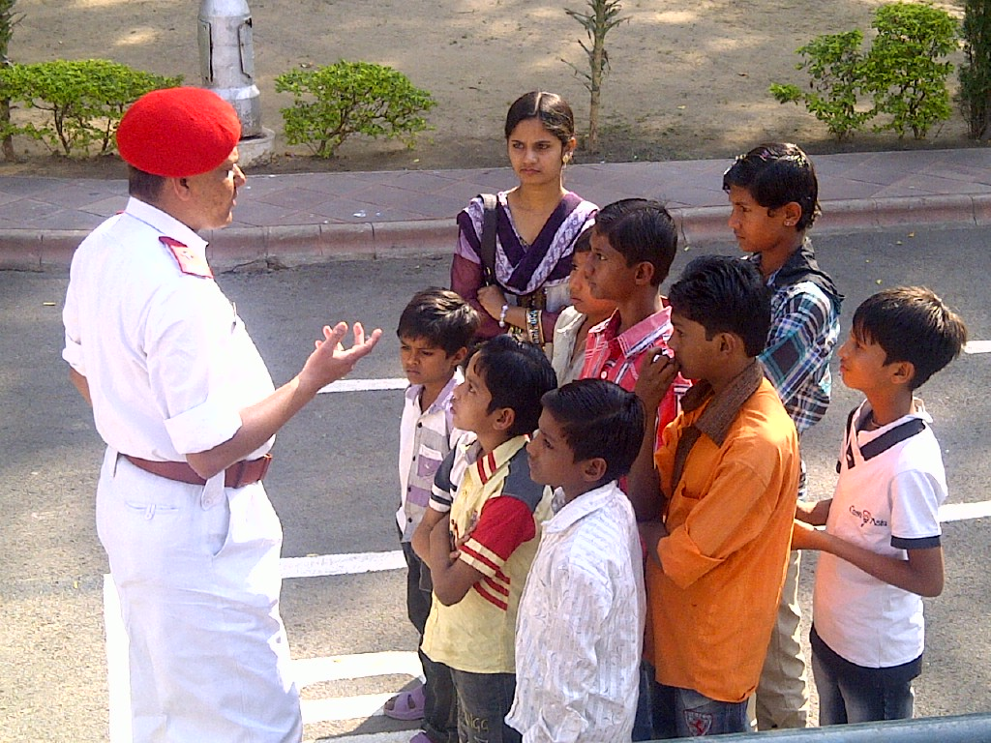
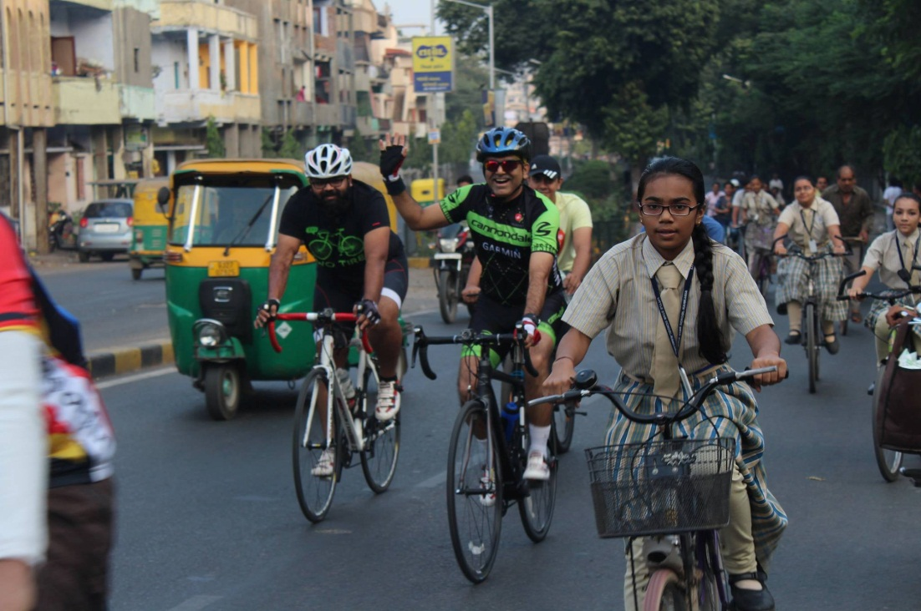
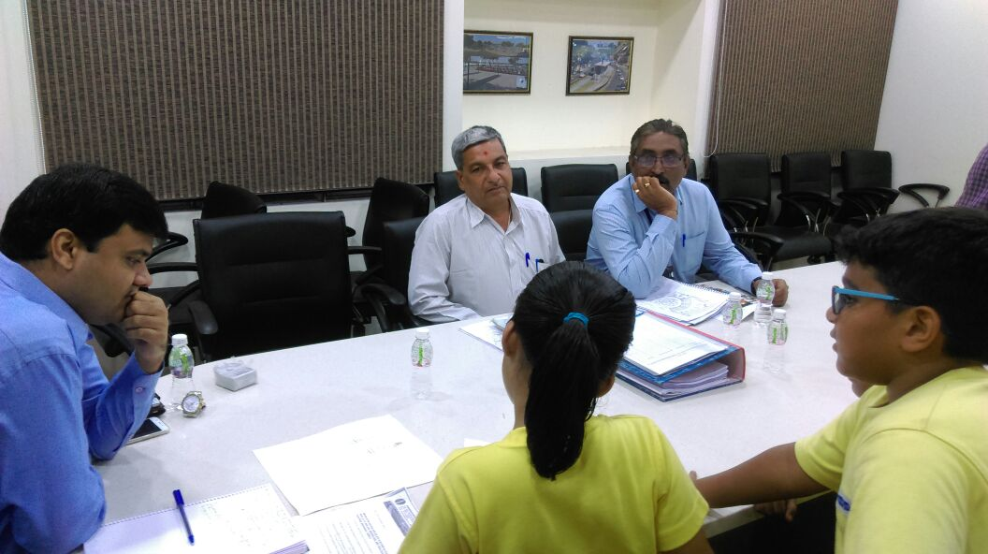
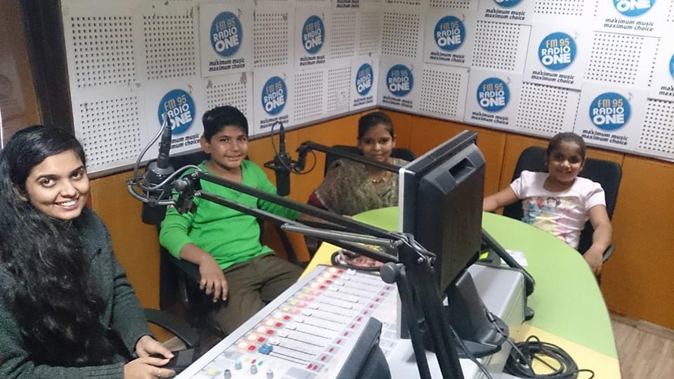
Practices
City on Cycles
Mov’ing Experience
Apprenticeship Program
Gift A Skill Initiative

Slide 9
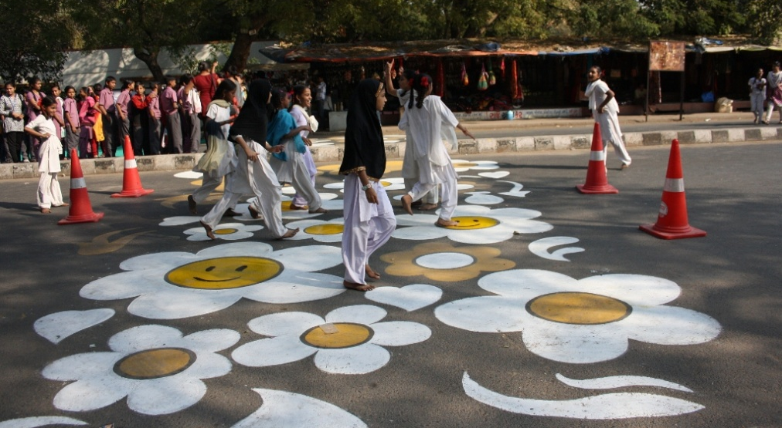
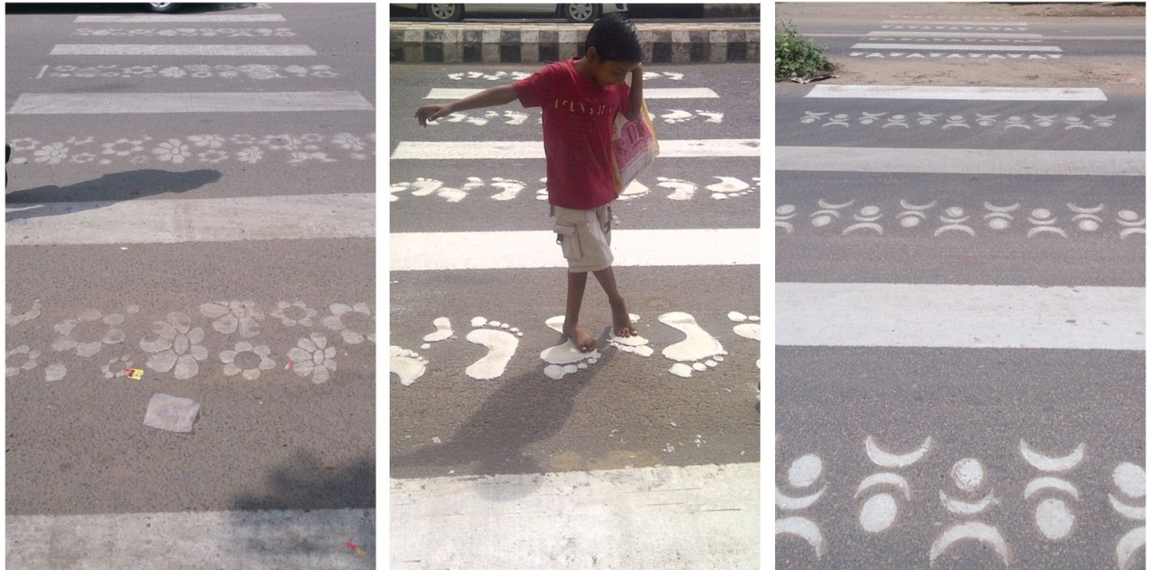
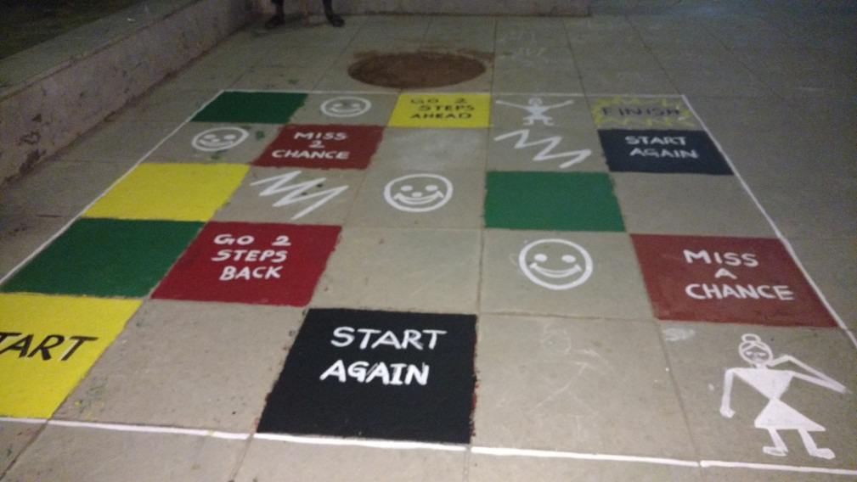
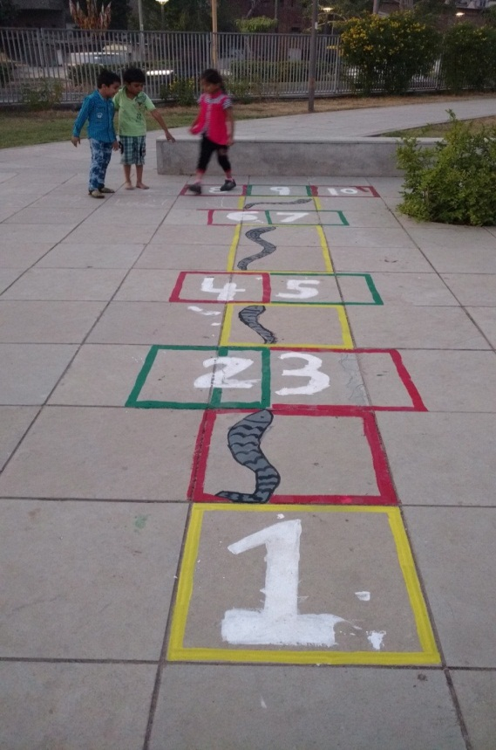
Innovation that Impacted Change
Child Friendly Zebra Crossing & games
Notes:
Play space needs to be of high quality and good design to attract children and families and become a valued part of the local environment

Slide 10
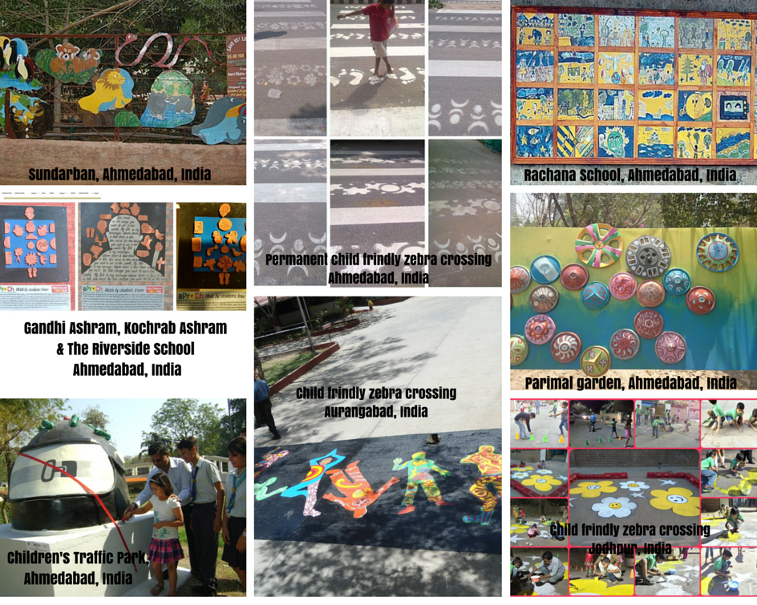
City as my landscape

Slide 11
Child Friendly City
Inclusivity
Community
Accessibility
Exposure
Opportunity
Bringing all stakeholders together
Making city fun, safe & affordable

Slide 12
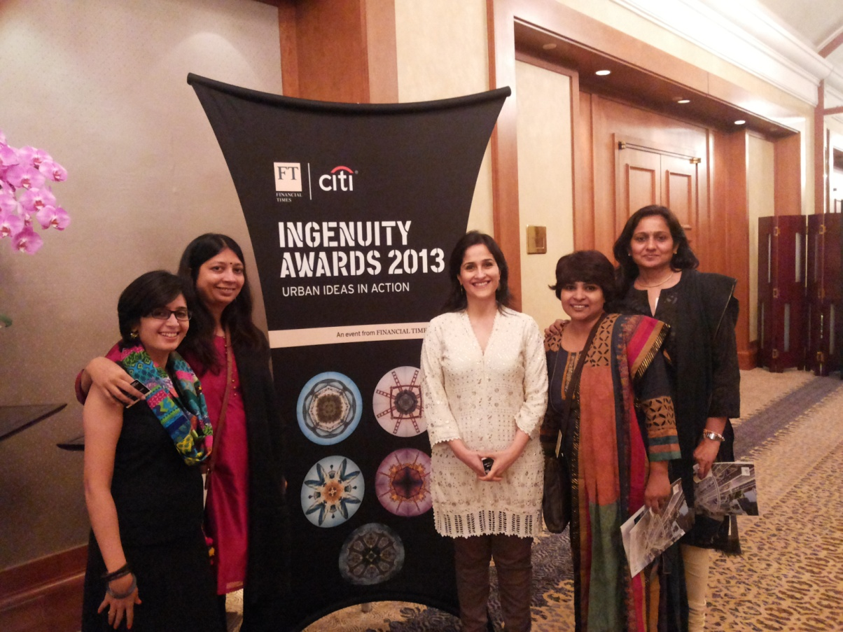
Awards
Ashoka Fellowship 2008 awarded to Kiran Sethi
Runner up for Asia Pacific Region of FT/Citi Urban Ingenuity Award for 2013 -2014.
Recipient of Pro Bono consultancy Award by AmEx Serve2Gether for 2013.
Research paper accepted for ‘Child in the City’ Conference in 2016 at Belgium by European network of Child friendly cities.

